Slide 1
18PYB103J
SEMICONDUCTOR PHYSICS
MODULE 4
LECTURE 14 – FUNDAMENTAL LAWS OF ABSORPTION
INSTRUMENTATION OF UV-VIS SPECTROSCOPY

Slide 2
Ultraviolet-Visible Spectroscopy
Reflectance or absorbance spectroscopy
Ultraviolet-visible region
Perceived colour of chemicals involved
Molecules undergo electronic transitions (Transition from ground state to excited state)
Complimentary to Fluorescence spectroscopy (Transition from excited state to ground state)

Slide 3
Ultraviolet-Visible Spectroscopy
Radiant Power, P: Rate of energy radiation reaching given area of detector per second, Incident power P₀, Transmitted power P
Transmittance, T: Ratio of transmitted (P) and incident radiant power (P₀)
Absorbance, A: Optical density or extinction
Absorptivity, a: Extinction coefficient (K), absorption index, specific extinction, specific absorbance
where ‘b’ is path length, ‘c’ is concentration of solution.

Slide 4
Ultraviolet-Visible Spectroscopy
Molar Absorptivity, ε: Molar Extinction coefficient, Molar absorption index, Molar absorption coefficient
where ‘M’ is molecular weight.
Path length, b: Internal thickness/diameter of cell, cylindrical
Slit width, SW: Mechanical distance between two narrow holes provided for entrance and exit of light in a monochromator
Visible light : Radiant energy to which human eye is susceptible, wavelength range is 380-780 nm

Slide 5
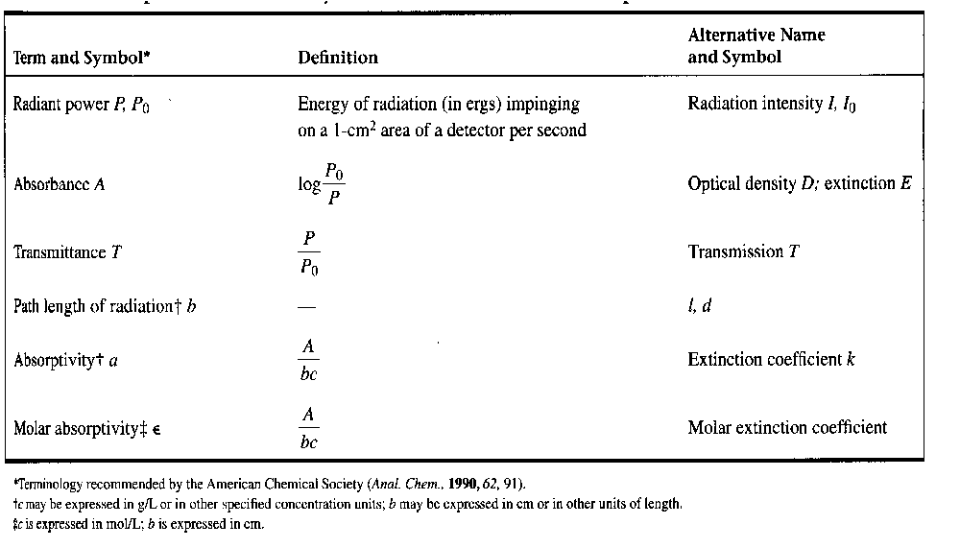
Absorption Variables

Slide 6
Fundamental Laws of Absorption :
1. Lambert’s or Bougert’s Law :
Relation between thickness of test sample to ratio of two radiant powers
All factors being equal, radiant power to decrease with increase in thickness of test sample
If a monochromatic radiation passes through a transparent medium, the rate of decrease of radiant power with the thickness of medium is proportional to power of radiation.
dP/dx = KP
where ‘P’ is radiant power at any instance ‘x’ in absorbing medium, ‘K’ a constant characteristic of absorbing medium and wavelength

Slide 7
Fundamental Laws of Absorption :
2. Beer’s Law :
Relation between concentration and transmittance
An exponential decrease in power of radiation with successive increase in concentration of test solution
With increase in concentration of absorbing substance, there is an increase in number of photos absorbed
Correspondingly, a decrease in power of transmitted radiation
When a monochromatic radiation passed through a medium containing an absorbing substances, the rate of decrease of power with concentration of absorbing species is directly proportional to intensity of radiation.
- dP/dc = K” P
where ‘c’ is concentration of absorbing species, K” a constant characteristic of system.

Slide 8
3. Combined Lambert-Beer Law :
Relation between both thickness and concentration
log 10 Po/P = abc Po/P= 10^{abc}
Po = P x 10^{abc}
Where ‘c’ is concentration of absorbing substance, ‘b’ is thickness, ‘a’ is a constant as absorptivity dependent of K and K”

Slide 9
3. Combined Lambert-Beer Law :
Concentration expressed in g moles/litre
log ₁₀ P_{o}/P = ε bc
ε = 1/b
P_{o} = P x 10^{abc}
Where ‘ε’ is molar absorptivity or molar extinction coefficient

Slide 10
Absorbance and Transmittance Spectrum
Graph – Wavelength vs Absorbance
Graph – Wavelength vs Transmittance
Solutions of higher concentration appear deeper in colour
Increase in concentration, increase in absorbance
For a sample, energy of absorption is singular, absorption spectrum also singular
Qualitative identification of a compound absorption spectrum
Peak represents maximum absorbance
Corresponding wavelength, maximum absorbance, minimum transmittance

Slide 11
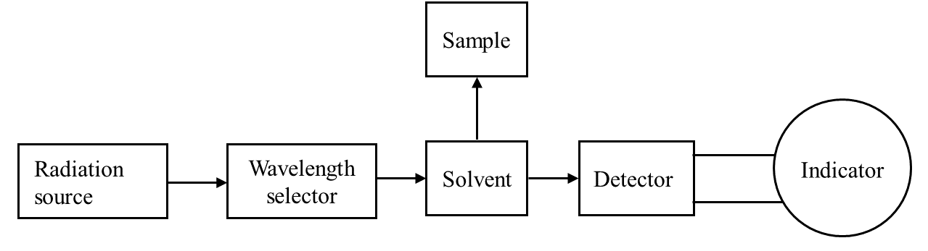
UV-Visible Spectroscopy Instrumentation:

Slide 12
Instrumentation of UV Spectroscopy
Light Source
Tungsten filament lamps and Hydrogen-Deuterium lamps are most widely used and suitable light source as they cover the whole UV region.
Tungsten filament lamps are rich in red radiations; more specifically they emit the radiations of 375 nm, while the intensity of Hydrogen-Deuterium lamps falls below 375 nm.

Slide 13
Instrumentation of UV Spectroscopy
Sample and reference cells
One of the two divided beams is passed through the sample solution and second beam is passé through the reference solution.
Both sample and reference solution are contained in the cells.
These cells are made of either silica or quartz. Glass can’t be used for the cells as it also absorbs light in the UV region.

Slide 14
Instrumentation of UV Spectroscopy
Generally two photocells serve the purpose of detector in UV spectroscopy.
One of the photocell receives the beam from sample cell and second detector receives the beam from the reference.
The intensity of the radiation from the reference cell is stronger than the beam of sample cell. This results in the generation of pulsating or alternating currents in the photocells.

Slide 15
Instrumentation of UV Spectroscopy
Monochromator
Monochromators generally is composed of prisms and slits.
Most of the spectrophotometers are double beam spectrophotometers.
The radiation emitted from the primary source is dispersed with the help of rotating prisms.

Slide 16
Instrumentation of UV Spectroscopy
The various wavelengths of the light source which are separated by the prism are then selected by the slits such the rotation of the prism results in a series of continuously increasing wavelength to pass through the slits for recording purpose.
The beam selected by the slit is monochromatic and further divided into two beams with the help of another prism.

Slide 17
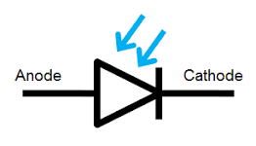
Instrumentation of UV Spectroscopy
Detector
Photo-diode symbol

Slide 18
Instrumentation of UV Spectroscopy
A photo detector is a semiconductor device which converts light energy to electrical energy.
It consists of a simple P-N junction diode and is designed to work in reverse biased condition.
The photons approaching the diode are absorbed by the photodiode and current is generated.
It can be made by defusing a p-type impurity into a n-type bulk silicon wafer or vice verse.

Slide 19
Instrumentation of UV Spectroscopy
The defused area is called active photodiode area which is coated by an anti reflecting thin film for maximum detection and is covered by an illumination window.
Non active area is deposited by thick layer of silicon oxide. Some photodiodes are manufactured with built-in filters and lenses having different surface areas.
Response time of the photodiode is inversely proportional to the surface area. Solar cell is one of the best examples for photodiode.
To increase the speed of response, a PIN junction is used instead of P-N junction

Slide 20
Instrumentation of UV Spectroscopy
Amplifier
The alternating current generated in the photocells is transferred to the amplifier.
The amplifier is coupled to a small servometer.
Generally current generated in the photocells is of very low intensity, the main purpose of amplifier is to amplify the signals many times so we can get clear and recordable signals.

Slide 21

Instrumentation of UV Spectroscopy
Recording devices
Most of the time amplifier is coupled to a pen recorder which is connected to the computer.
Computer stores all the data generated and produces the spectrum of the desired compound.

Slide 22
Applications of UV Spectroscopy
Detection of Impurities
Best methods for determination of impurities in organic molecules.
Additional peaks can be observed due to impurities in the sample and it can be compared with that of standard raw material.
By also measuring the absorbance at specific wavelength, the impurities can be detected.

Slide 23
Applications of UV Spectroscopy
Structure elucidation of organic compounds
It is useful in the structure elucidation of organic molecules, such as in detecting the presence or absence of unsaturation, the presence of hetero atoms.
UV absorption spectroscopy can be used for the quantitative determination of compounds that absorb UV radiation.

Slide 24
Applications of UV Spectroscopy
UV absorption spectroscopy can characterize those types of compounds which absorbs UV radiation thus used in qualitative determination of compounds. Identification is done by comparing the absorption spectrum with the spectra of known compounds.
This technique is used to detect the presence or absence of functional group in the compound. Absence of a band at particular wavelength regarded as an evidence for absence of particular group.
Kinetics of reaction can also be studied using UV spectroscopy. The UV radiation is passed through the reaction cell and the absorbance changes can be observed.

Slide 25
Applications of UV Spectroscopy
Many drugs are either in the form of raw material or in the form of formulation. They can be assayed by making a suitable solution of the drug in a solvent and measuring the absorbance at specific wavelength.
Molecular weights of compounds can be measured spectrophotometrically by preparing the suitable derivatives of these compounds.
UV spectrophotometer may be used as a detector for HPLC.

Slide 26
Applications of UV Spectroscopy
Analytical chemistry for quantitative determination of different anlalytes – Transition metal ions, highly conjugated organic compounds and biological macromolecules
Analysis of solutions, also solids and gases
Concentration of absorber in solution
As detector in HPLC
Wavelength of absorption peaks, correlated with types of bonds
Determination of functional groups within molecule

Slide 27


